Slide 1
… the long grass
yew brown cc project 2
pechakucha

Slide 2
concept
the long grass is a generative audio-visual artwork.
comprised of a music composition made up of 3 sub-pieces and a moving image piece to form a symbiotic whole.
the research focus of the project is on the application of abstract fractal and self-similar structures to audio-visual composition.
as a new way of achieving more nuanced expression and advanced technical ability within my own practice.
there may also be scope to extend into 4D geometry and develop underlying structures.
creatively, it features individual expression as well as exploration of music theory - e.g. rhythm, metre and microtonal harmony. extending similarly to moving image from a more rudimentary startpoint.
it expresses a personal web of experiences, observations and thoughts around nature, impermanence, emergence, meditation and non-self.
centred on an impression of the brightness, greenness and liveliness of midsummer.

Slide 3
addressing the brief
how is this related to boundaries?
this project will address the brief through exploring boundaries of recognition between iterations of fractal and self-similar structures and patterns. if possible, also to push deeper into more expansive and abstract hyperstructures.
assessing the balance between the underlying structures and how perceptible they are in the outcome of the piece may be a way to evaluate that aim.

Slide 4
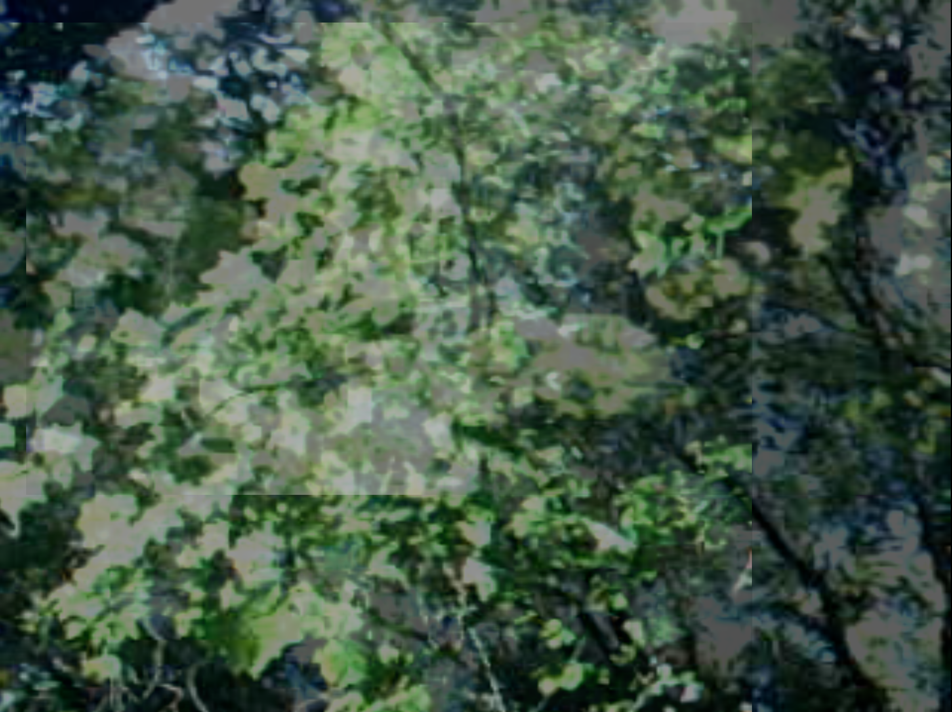
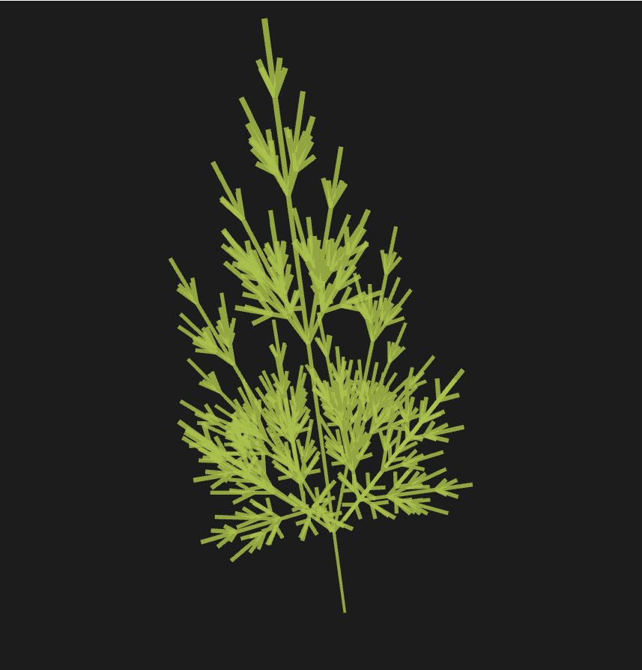
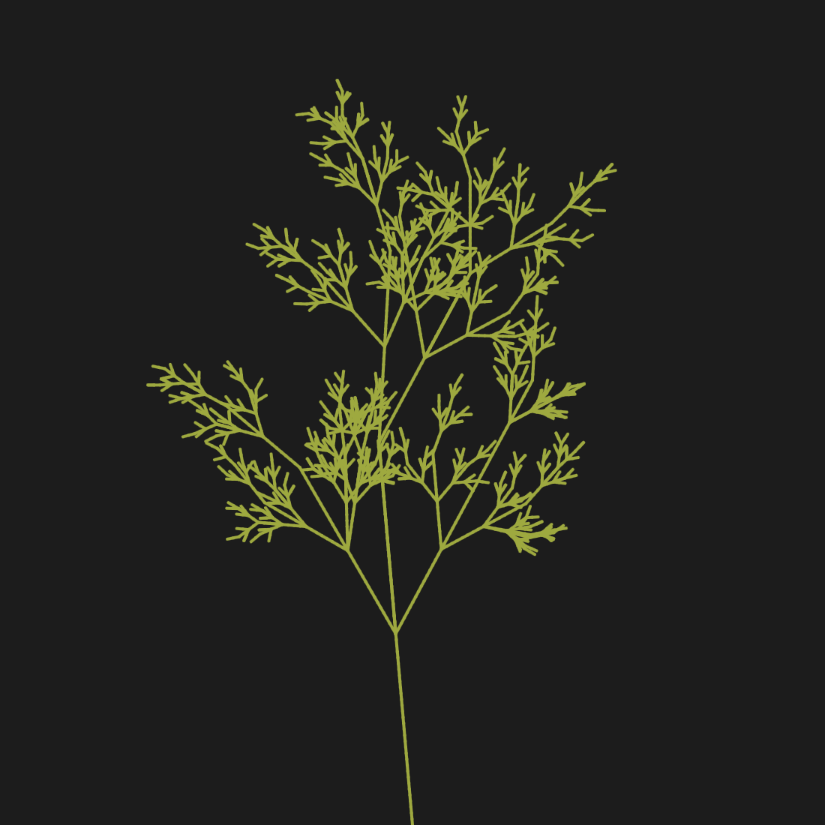
time
~ F[-X][+X][vX][^X]FX
~ F[-X][+X]FX
arr. left
arr. right

Slide 5
q | a
question phrase ends unresolved, on a dissonance | answer phrase ends resolved, on a consonance
every melody contains a unique pair of phrases: q & a
each new layer weaves 2 associated sub-layers of the previous along with the current layer
B1,E1,B2,E2 =
q | q | q | a | q | q | a | a | q | a | a | a
Bx |  | Bx |  | Bx |  | Ex |  | Bx |  | Bx |  | Ex |  | Ex |  | Bx |  | Ex |  | Ex |  | Ex
a | a | a | q | a | a | a | a | q | q | a | q | a | q | a | a | q | q | q | q | a | q | q | q
X, Y =
X |  | X |  | X |  | Y |  | X |  | X |  | Y |  | Y |  | X |  | Y |  | Y |  | Y
B1 | B1 | B1 | E1 | B1 | B1 | B2 | B2 | E1 | E1 | B1 | E1 | B2 | E2 | B2 | B2 | E1 | E1 | E2 | E2 | B2 | E2 | E2 | E2
Whole =

Slide 6
components and presentation
components and tech stack
music/sound:
fractal melody
harmonic cloud
field recordings
SuperCollider
moving image:
lofi handcam footage of midsummer foliage and greenery
footage manipulated and abstracted
structure visualisations
openFrameworks
structure:
external programme to generate l-system trees and dynamic structures
to using in mapping and arranging visual and sound elements
C++
ideal presentation
projection of visual piece
quadraphonic audio (4 speaker surround)
dim/dark, quiet space
visualisation of underlying structures
piece reactive to audience presence
beanbag/cushion seating
simple set/sculptural elements for atmosphere

Slide 7



